Slide 1
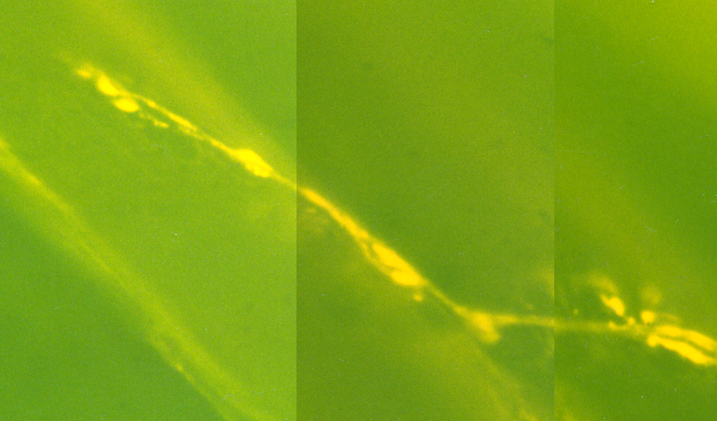
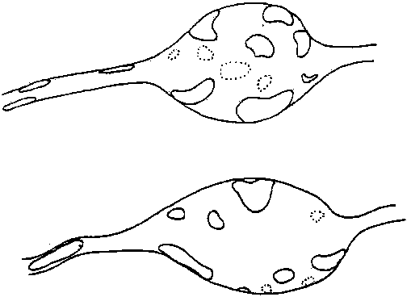
The neuromuscular junction

Slide 2
PRESYNAPTIC
POSTSYNAPTIC

Slide 3
PRESYNAPTIC
AP
POSTSYNAPTIC

Slide 4
Not saturated

Slide 5
Saturated
Notes:
Given two synapses. One saturated one not. Saturdated one might give a slight larger amp, given more receptors get bound, then probably one will see a broader and flatter peak. Receptor /transmitter rebound-not cleared and activation/inactivation would occur.

Slide 6
Not saturated
Off center
Notes:
Smaller EPSC with same time constant.

Slide 7
Not saturated
Saturated due to
smaller synapse
With same amount
of transmitter
Notes:
Shorter and braoder. Time constant reduced or two curves

Slide 8
3
1
2
Not saturated to
saturated based on
vesicle size and amount
released.
1
2
3

Slide 9
Not saturated
but not enough time
to recycle and refill
Time

Slide 10
RP
Not saturated
but not enough time
to recycle and refill
but can recruit from RP
Time
RP

Slide 11
Not saturated
but increase density
of postsynaptic receptor
density
Time
Test ?
Notes:
So how to test such possibilities? Density with exogenous application. But the other issues are more difficult. In addition one has to think of structure of the synapses. Both pre and post as the effect the recordings and which type of recording is made.

Slide 12
Focal recording
Intracellular muscle
recording
nerve
muscle
Case 1:
Case 2:
Missing quanta

Slide 15
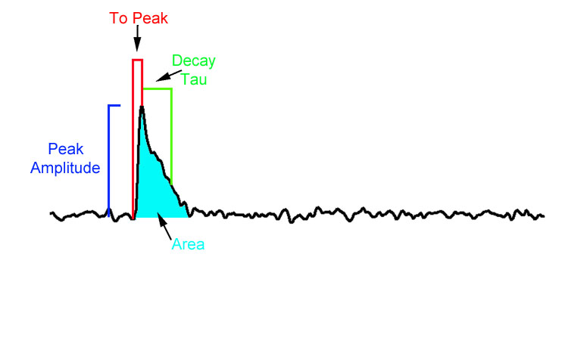
Classical Quantal Counting Methods vs. New Stochastic Measurements.
More accurately measure n and p.
Find subsets of quantal events.
Analysis program by Mark Lancaster will allow measurements of all these parameters.

